Slide 1
National Economic Education Delegation
Vision
  One day, the public discussion of policy issues will be grounded in an accurate perception of the underlying economic principles and data.
Mission
  NEED unites the skills and knowledge of a
  vast network of professional economists to promote understanding of the economics of policy issues in the United States.
NEED Presentations
  Are nonpartisan and intended to reflect the consensus of the economics profession.

Slide 2
China’s Belt and Road Initiative:
What is it?
And is it good or bad for the United States?
Alan V. Deardorff
University of Michigan
For presentation at Adult Learning Institute
Oakland Community College
October 16, 2019

Slide 3
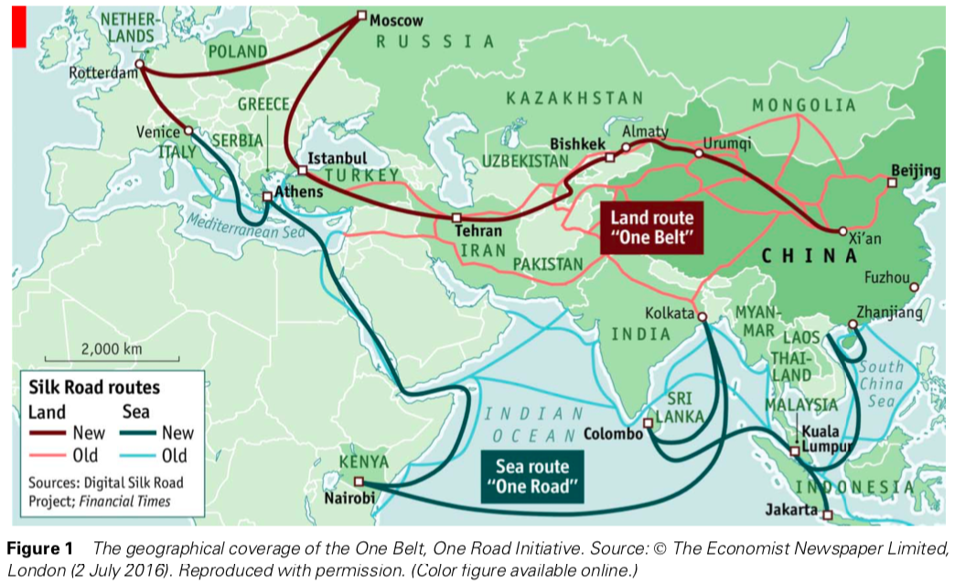
Notes:
Sidaway, James D. & Chih Yuan Woon, ”Chinese Narratives on “One Belt, One Road” in Geopolitical and Imperial Contexts,” The Professional Geographer, 69:4, 591-603, November 2017.

Slide 4
Outline: The Belt and Road Initiative
What it is
Projects
History
Before BRI
Effects of BRI
Pros and cons
Implications for United States

Slide 5
BRI: What it is
BRI is (from Deardorff’s Glossary of International Economics)
  Initially called the One Belt, One Road Initiative,
  this is a massive undertaking by the Chinese government to build infrastructure
    on land (the belt), and
    on sea (the road)
  between China and
    other parts of Asia,
    Europe, and
    Africa

Slide 6
BRI: What it is
As stated by Cavanna 2018 BRI is
  “$4 trillion of promised investments
  in 65 countries representing
    70 percent of the world’s population,
    55 percent of its GNP, and
    75 percent of its energy resources?”
Notes:
Cavanna, Thomas P., “What Does China’s Belt and Road Initiative Mean for US Grand Strategy?” The Diplomat, June 5, 2018.
https://thediplomat.com/2018/06/what-does-chinas-belt-and-road-initiative-mean-for-us-grand-strategy/

Slide 7
BRI
Projects of BRI

Slide 8
BRI: What it is
BRI infrastructure projects (BRI Website lists 118)
  The “Belt”
    Railroads
    Light rail and mass transit
    Roads
    Airports
    Dams
    Gas pipelines
    Fiber optics
    Power plants (coal, gas, hydro, solar, wind)
    Transmission lines
  The “Road”
    Ports
    Harbors

Slide 9
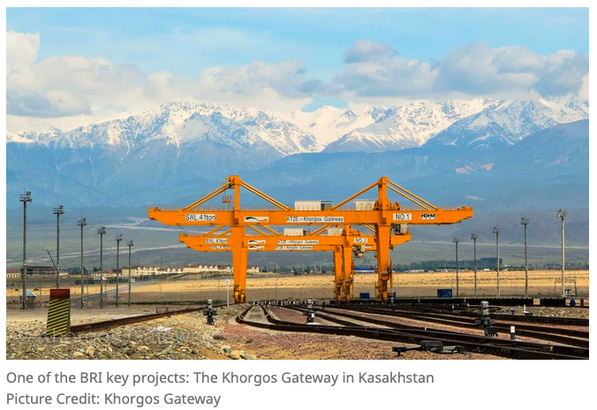
KAZAKHSTAN
Notes:
https://www.beltroad-initiative.com/projects/

Slide 10
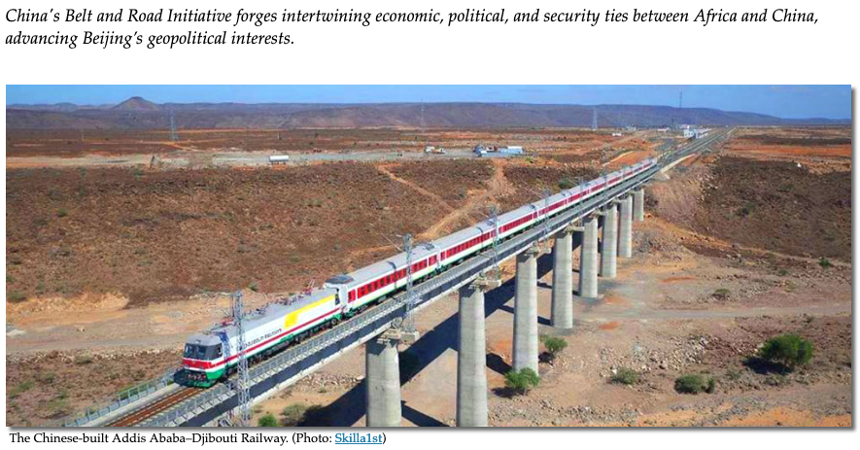
ETHIOPIA-DJIBOUTI
Notes:
https://africacenter.org/spotlight/implications-for-africa-china-one-belt-one-road-strategy/

Slide 11
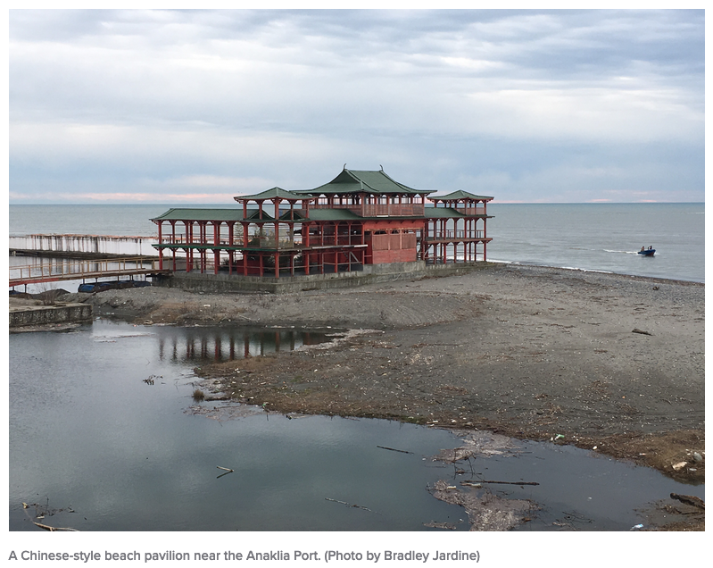
GEORGIA

Slide 12
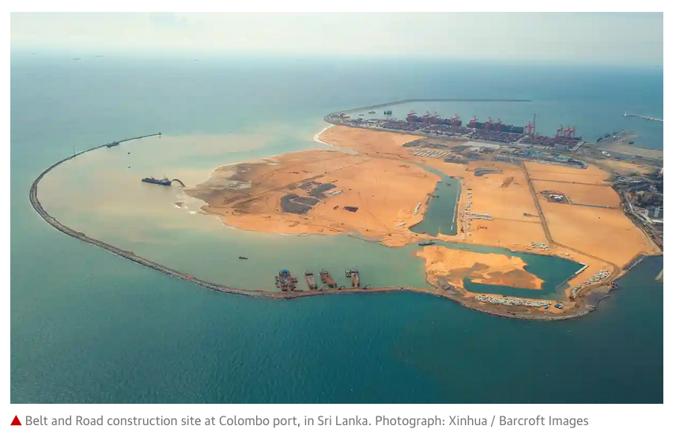
SRI LANKA
Notes:
https://www.theguardian.com/world/2019/mar/20/italy-rattles-us-and-eu-with-likely-support-for-chinas-belt-and-road

Slide 13
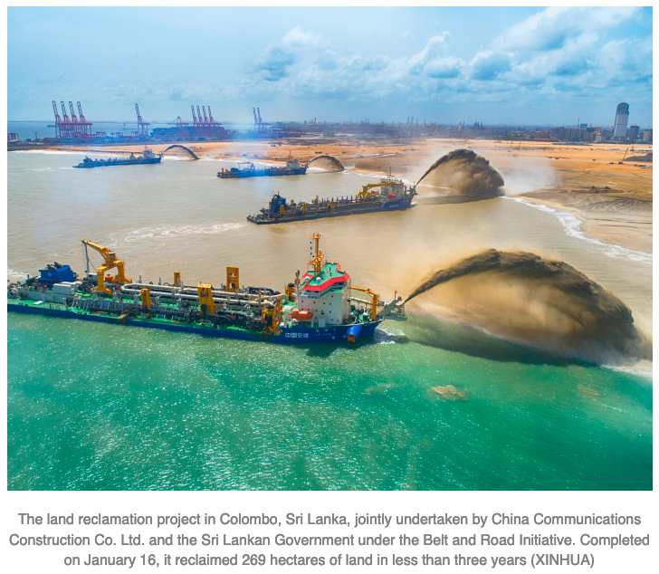
SRI LANKA
Notes:
http://www.bjreview.com/World/201903/t20190325_800163134.html

Slide 14
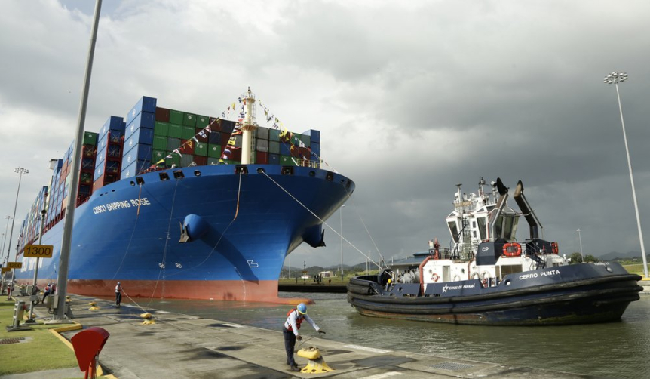
PANAMA

Slide 15
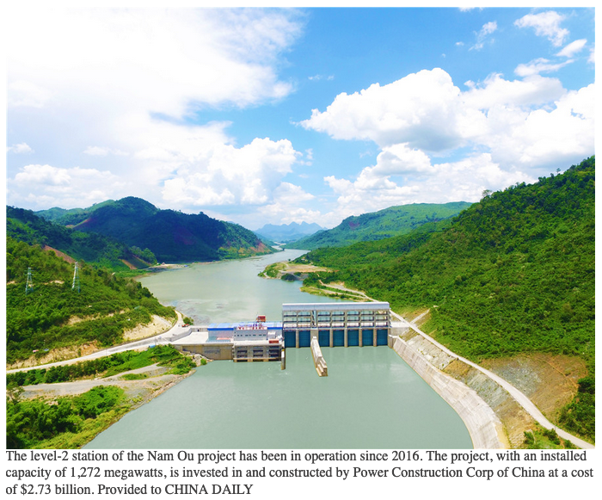
LAOS
Notes:
http://www.chinadaily.com.cn/a/201904/01/WS5ca14b32a3104842260b389d.html

Slide 16
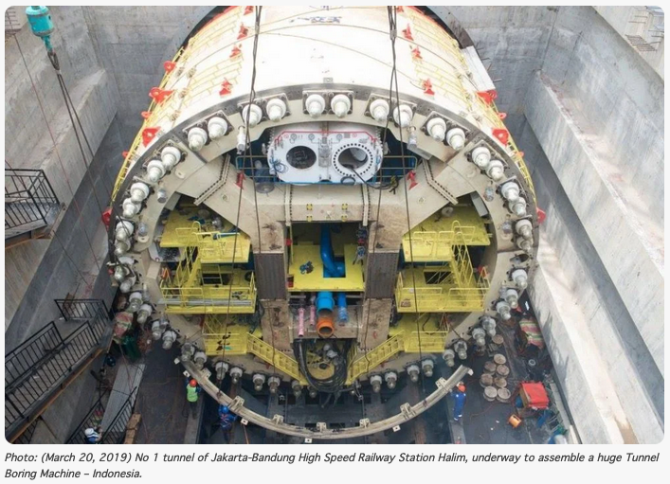
INDONESIA
Notes:
https://www.beltandroad.news/2019/04/06/10-amazing-belt-and-road-initiative-projects/

Slide 17
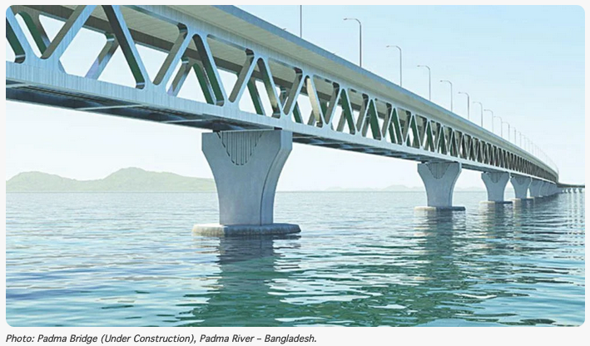
BANGLADESH
Notes:
https://www.beltandroad.news/2019/04/06/10-amazing-belt-and-road-initiative-projects/

Slide 18
BRI
History

Slide 19
BRI: History
The Ancient Silk Road
  A trade route from between
    Asia (including East, South-East, and South Asia),
    East Africa, and
    Europe
  Opened in 130 BC, remained in use until 1453 AD
    Closed by Ottoman Empire

Slide 20
BRI: History
The Ancient Silk Road(s)
  Named for trade in silk, but also traded much more (per History.com) :
    fruits and vegetables, livestock, grain, leather and hides, tools, religious objects, artwork, precious stones and metals
    language, culture, religious beliefs, philosophy and science.
    paper and gunpowder, both invented by the Chinese
  Name is recent, per UNESCO. It had no name when being used. Named in mid-19th century:
    by German geologist, Baron Ferdinand von Richthofen,
    Die Seidenstrasse (the Silk Road)
Notes:
https://www.history.com/topics/ancient-middle-east/silk-road
https://en.unesco.org/silkroad/about-silk-road

Slide 21
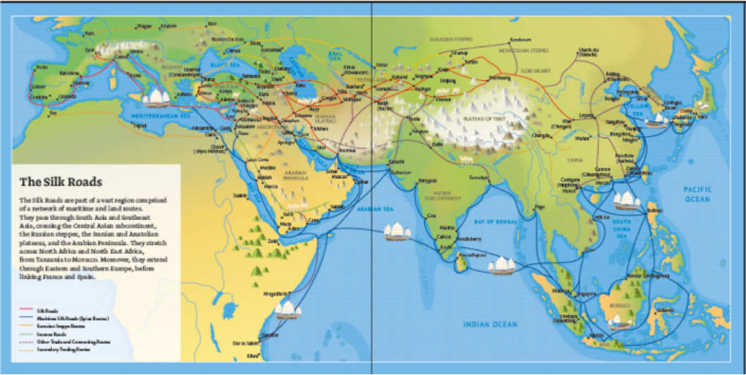
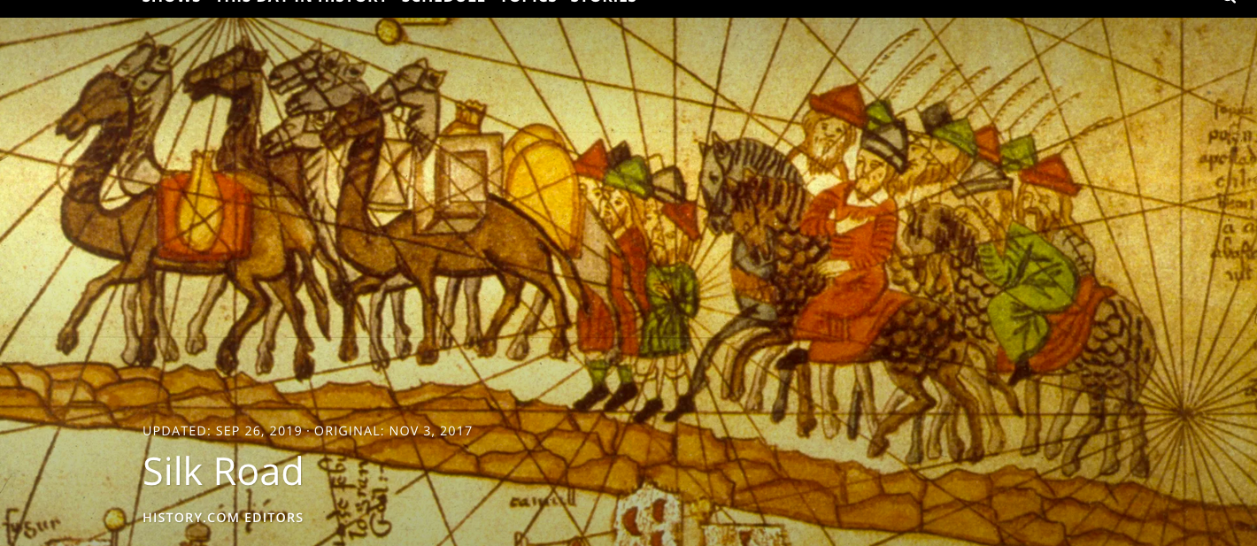
Source: History.com
Notes:
https://www.history.com/topics/ancient-middle-east/silk-road

Slide 22
Source: History.com
Notes:
https://www.history.com/topics/ancient-middle-east/silk-road

Slide 23
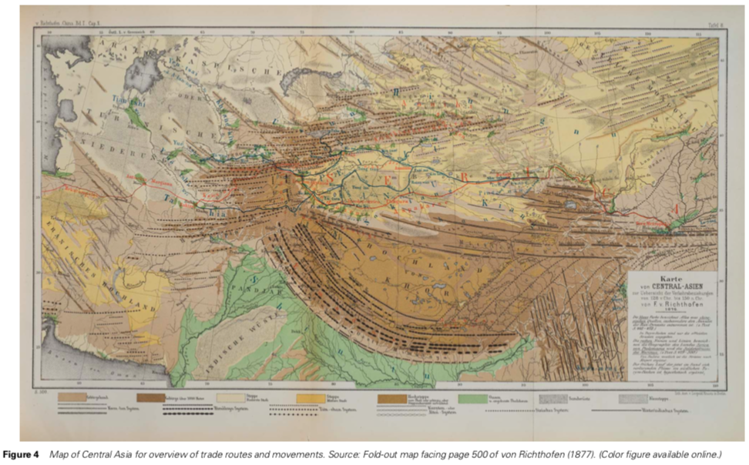
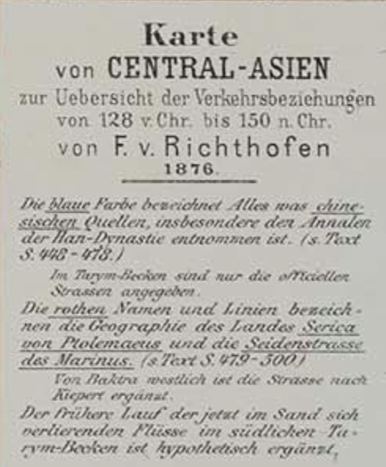
Notes:
Sidaway, James D. & Chih Yuan Woon, ”Chinese Narratives on “One Belt, One Road” in Geopolitical and Imperial Contexts,” The Professional Geographer, 69:4, 591-603, November 2017.

Slide 24
Notes:
Sidaway, James D. & Chih Yuan Woon, ”Chinese Narratives on “One Belt, One Road” in Geopolitical and Imperial Contexts,” The Professional Geographer, 69:4, 591-603, November 2017.

Slide 25
BRI: History
The Belt and Road Initiative
  Announced by China’s President Xi Jinping, 2013
  Two prongs:
    Overland Silk Road Economic Belt
    Maritime Silk Road
  Purpose: To “break the bottleneck of Asian connectivity”
  Coverage: Over 60 countries have signed on or indicated interest
  Cost: Estimated to total $1.2-1.3 trillion by 2027
  Motivation: Counter to the US “Pivot to Asia” under Obama
Notes:
Chatzky, Andrew and James McBride,”China’s Massive Belt and Road Initiative,” backgrounder, Council on Foreign Relations, updated May 21, 2019.
https://www.cfr.org/backgrounder/chinas-massive-belt-and-road-initiative

Slide 26
BRI: History
Additional BRI purposes
  Help China be more assertive in world affairs
  New markets for China’s consumer goods and excess industrial capacity
  Pushback against US influence
  Develop new investment opportunities
  Boost Chinese income and domestic consumption
  Shape international norms and institutions
  Improve China’s image among its neighbors
  Boost links to historically neglected western regions of China
  Secure long-term energy supplies
  Restructure economy to avoid the “middle-income trap”
Notes:
Chatzky, Andrew and James McBride,”China’s Massive Belt and Road Initiative,” backgrounder, Council on Foreign Relations, updated May 21, 2019.
https://www.cfr.org/backgrounder/chinas-massive-belt-and-road-initiative

Slide 27
BRI: History
Countries pledging support for BRI:
    (Incomplete list of MOUs and Joint Statements/Communiques)
  2014: Thailand, Timor-Leste
  2015: Azerbaijan, Bulgaria, Czech Republic, Hungary, Indonesia, Kazakhstan, Poland, Romania, Serbia, Slovakia, South Africa, Turkey
  2016: Egypt, Latvia, Myanmar, Papua New Guinea
  2017: Albania, Bosnia & Herzegovina, Croatia, Finland, Israel, Lebanon, Madagascar, Maldives, Montenegro, Morocco, New Zealand, Panama, Philippines, UAE
  2018: Afghanistan, Algeria, Antigua & Barbuda, Bahrain, Bolivia, Cameroon, Chile, Costa Rica, Cote d’Ivoire, Ecuador, Ethiopia, Fiji, France, Ghana, Greece, Grenada, Guyana, Kenya, Libya, Malta, Nigeria, Niue, Oman, Pakistan, Portugal, Rwanda, Samoa, Senegal, Seychelles, Sierra Leone, Singapore, Somalia, Tonga, Trinidad & Tobago, Tunisia, Vanuatu
  2019: Barbados, Italy, Jamaica, Luxembourg
Notes:
Ibold, Sebastian, “Cooperation agreements and MoUs under the Belt and Road Initiative,” Belt and Road Initiative.
https://www.beltroad-initiative.com/memorundum-of-understanding-belt-and-road-initiative/#more-1881

Slide 28
BRI: History
Many in Asia, but also
Europe
Middle East
Africa
Americas
Countries pledging support for BRI:
    (Incomplete list of MOUs and Joint Statements/Communiques)
  2014: Thailand, Timor-Leste
  2015: Azerbaijan, Bulgaria, Czech Republic, Hungary, Indonesia, Kazakhstan, Poland, Romania, Serbia, Slovakia, South Africa, Turkey
  2016: Egypt, Latvia, Myanmar, Papua New Guinea
  2017: Albania, Bosnia & Herzegovina, Croatia, Finland, Israel, Lebanon, Madagascar, Maldives, Montenegro, Morocco, New Zealand, Panama, Philippines, UAE
  2018: Afghanistan, Algeria, Antigua & Barbuda, Bahrain, Bolivia, Cameroon, Chile, Costa Rica, Cote d’Ivoire, Ecuador, Ethiopia, Fiji, France, Ghana, Greece, Grenada, Guyana, Kenya, Libya, Malta, Nigeria, Niue, Oman, Pakistan, Portugal, Rwanda, Samoa, Senegal, Seychelles, Sierra Leone, Singapore, Somalia, Tonga, Trinidad & Tobago, Tunisia, Vanuatu
  2019: Barbados, Italy, Jamaica, Luxembourg
Notes:
Ibold, Sebastian, “Cooperation agreements and MoUs under the Belt and Road Initiative,” Belt and Road Initiative.
https://www.beltroad-initiative.com/memorundum-of-understanding-belt-and-road-initiative/#more-1881

Slide 29
BRI: History
Many in Asia, but also
Europe
Middle East
Africa
Americas
Countries pledging support for BRI:
    (Incomplete list of MOUs and Joint Statements/Communiques)
  2014: Thailand, Timor-Leste
  2015: Azerbaijan, Bulgaria, Czech Republic, Hungary, Indonesia, Kazakhstan, Poland, Romania, Serbia, Slovakia, South Africa, Turkey
  2016: Egypt, Latvia, Myanmar, Papua New Guinea
  2017: Albania, Bosnia & Herzegovina, Croatia, Finland, Israel, Lebanon, Madagascar, Maldives, Montenegro, Morocco, New Zealand, Panama, Philippines, UAE
  2018: Afghanistan, Algeria, Antigua & Barbuda, Bahrain, Bolivia, Cameroon, Chile, Costa Rica, Cote d’Ivoire, Ecuador, Ethiopia, Fiji, France, Ghana, Greece, Grenada, Guyana, Kenya, Libya, Malta, Nigeria, Niue, Oman, Pakistan, Portugal, Rwanda, Samoa, Senegal, Seychelles, Sierra Leone, Singapore, Somalia, Tonga, Trinidad & Tobago, Tunisia, Vanuatu
  2019: Barbados, Italy, Jamaica, Luxembourg
Notes:
Ibold, Sebastian, “Cooperation agreements and MoUs under the Belt and Road Initiative,” Belt and Road Initiative.
https://www.beltroad-initiative.com/memorundum-of-understanding-belt-and-road-initiative/#more-1881

Slide 30
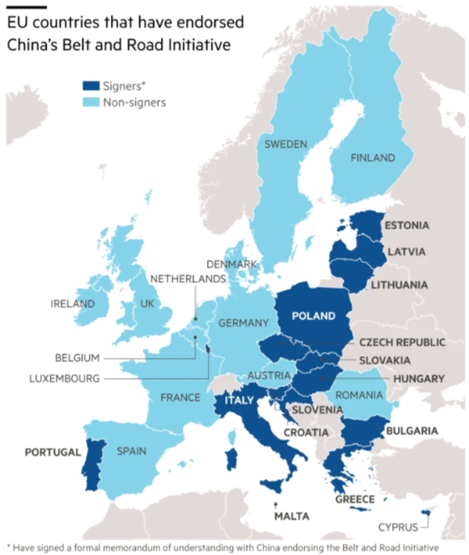
Source: Peel & Hornby, 2019
Notes:
Peel, Michael and Lucy Hornby, “China pledges open Belt and Road but west is split on project,” Financial Times, April 26, 2019.

Slide 31
BRI Corridors
Land route (the “Belt”) will include six “corridors”
  China-Pakistan
  Bangladesh-China-India-Myanmar
  China-Central Asia-West Asia
  China-Indochina Peninsula
  China-Mongolia-Russia
  New Eurasia Land Bridge
Notes:
Ibold, Sebastian, “Cooperation agreements and MoUs under the Belt and Road Initiative,” Belt and Road Initiative.
https://www.beltroad-initiative.com/memorundum-of-understanding-belt-and-road-initiative/#more-1881

Slide 32
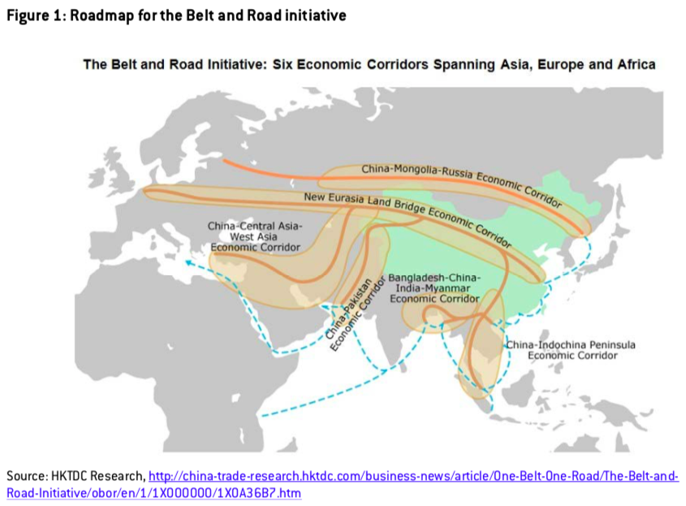
Source: Garcia-Herrero & Xu, 2016
Notes:
García-Herrero, Alicia and Jianwei Xu, “China’s Belt and Road Initiative: Can Europe expect trade gains?,” Bruegel Working Paper, No. 2016/5, 2016.

Slide 33
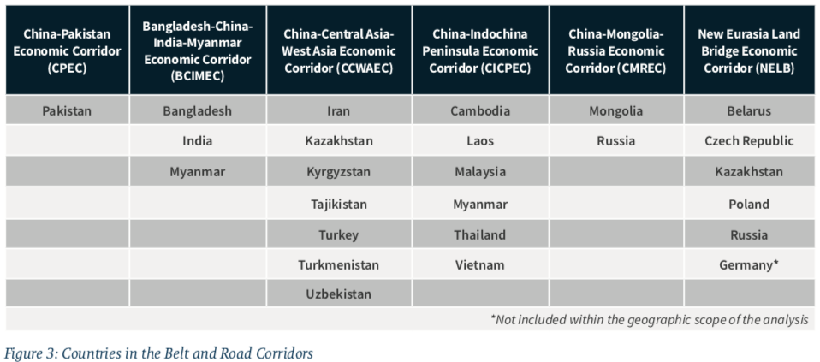
Source: Hillman, 2018
Notes:
Hillman, Jonathan, “China’s Belt and Road Is Full of Holes,” CSIS Briefs, Center for Strategic and International Studies, September 2018.

Slide 34
BRI
Before BRI

Slide 35
BRI: BRI Countries before BRI
Countries differed in
  Trade
  Direct investment
  Participation in global value chains
  Time to trade
  Rule of law
  Time to start a business
Infrastructure investment needs
Notes:
Ibold, Sebastian, “Cooperation agreements and MoUs under the Belt and Road Initiative,” Belt and Road Initiative.
https://www.beltroad-initiative.com/memorundum-of-understanding-belt-and-road-initiative/#more-1881

Slide 36
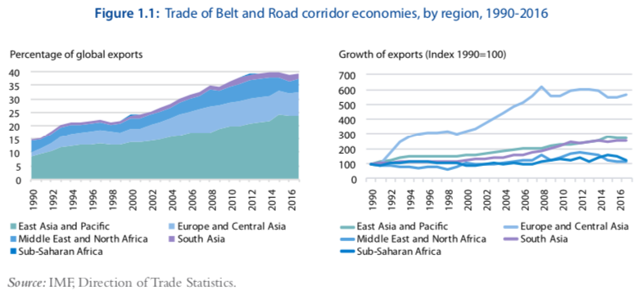
Trade was growing, especially for East Asia.
Source: World Bank, 2019, Belt and Road Economics: Opportunities and Risks of Transport Corridors
Notes:
World Bank 2019

Slide 37
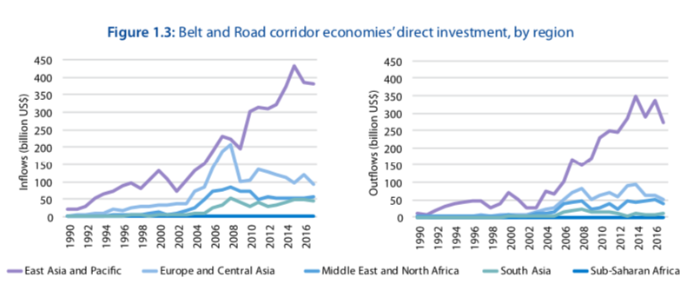
Investment was growing more recently, especially for East Asia.
Source: World Bank, 2019, Belt and Road Economics: Opportunities and Risks of Transport Corridors
Notes:
World Bank 2019

Slide 38
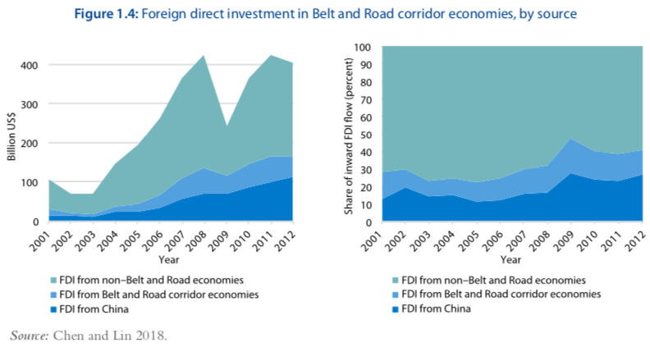
Investment was mostly from non-BRI countries.
Source: World Bank, 2019, Belt and Road Economics: Opportunities and Risks of Transport Corridors
Notes:
World Bank 2019

Slide 39
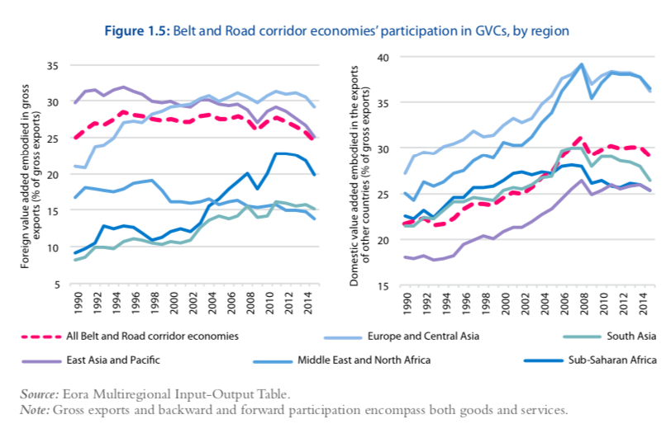
Participation in Global Value Chains was moderate.
Source: World Bank, 2019, Belt and Road Economics: Opportunities and Risks of Transport Corridors
Notes:
World Bank 2019

Slide 40
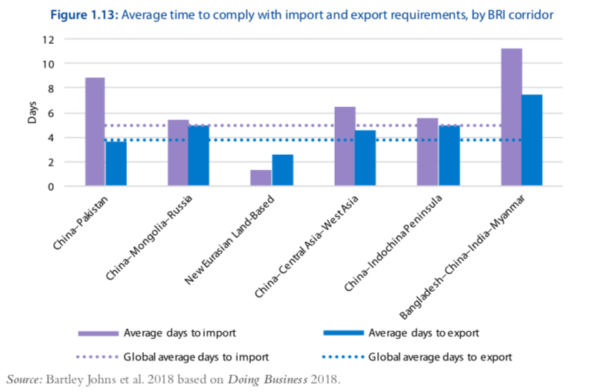
Time to trade was often excessive.
Source: World Bank, 2019, Belt and Road Economics: Opportunities and Risks of Transport Corridors
Notes:
World Bank 2019

Slide 41
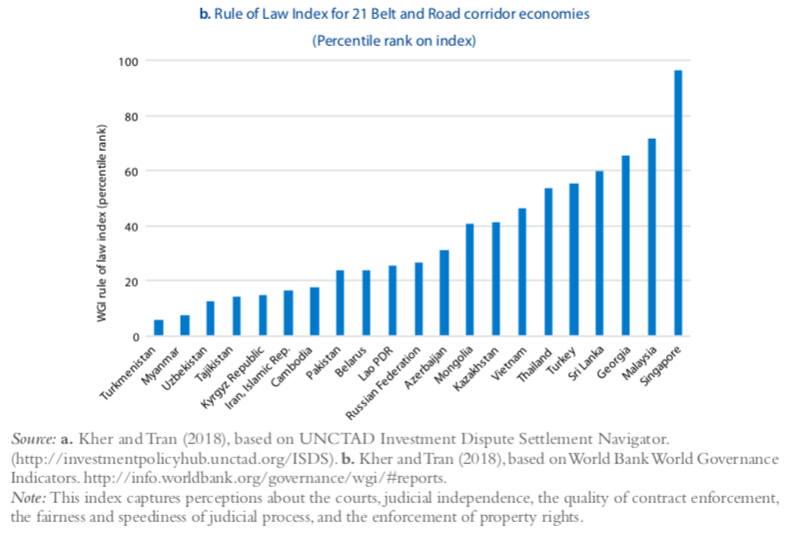
Many had weak Rule of Law.
Source: World Bank, 2019, Belt and Road Economics: Opportunities and Risks of Transport Corridors
Notes:
World Bank 2019

Slide 42
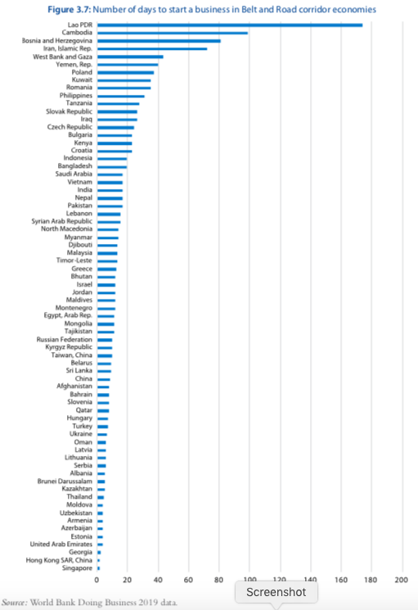
Days to start a business was often excessive.
Notes:
World Bank 2019

Slide 43
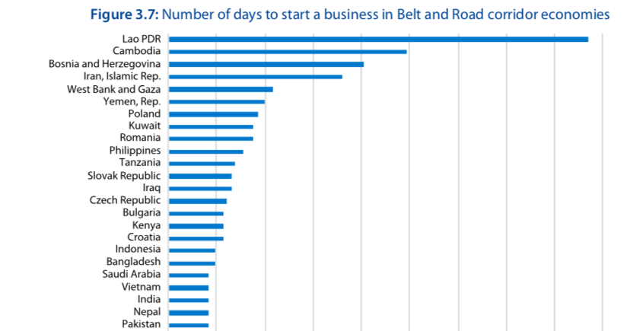
Days to start a business was often excessive.
Notes:
World Bank 2019

Slide 44
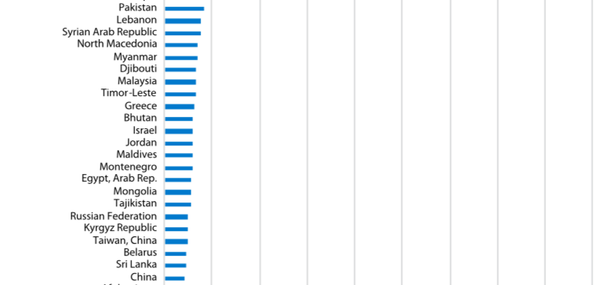
Days to start a business was often excessive.
Notes:
World Bank 2019

Slide 45
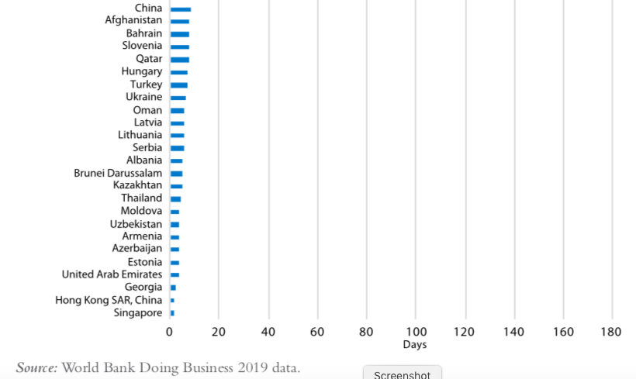
Days to start a business was often excessive.
Notes:
World Bank 2019

Slide 46
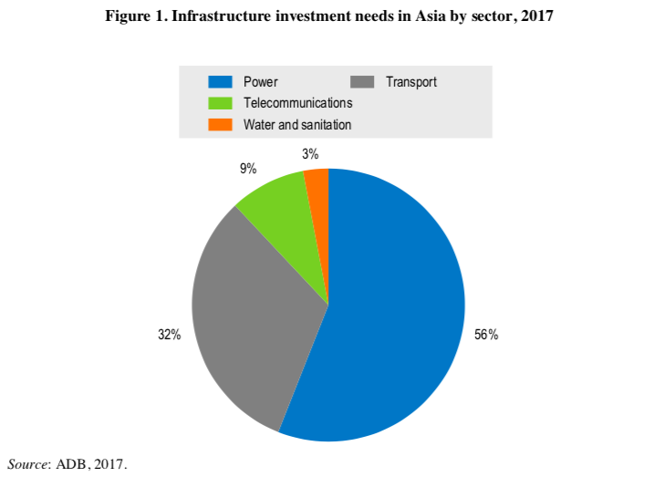
Infrastructure needs were greatest in Power and Transport
Source: OECD 2018
Notes:
OECD, “China’s Belt and Road Initiative in the global trade, investment and finance landscape,” Chapter 2 of OECD Business and Economic Outlook, 2018.
https://www.google.com/url?sa=t&rct=j&q=&esrc=s&source=web&cd=17&ved=2ahUKEwiiqN62ipDlAhUMY6wKHUCrCzQQFjAQegQICRAC&url=https%3A%2F%2Fwww.oecd.org%2Ffinance%2FChinas-Belt-and-Road-Initiative-in-the-global-trade-investment-and-finance-landscape.pdf&usg=AOvVaw10mHVlaLTSNB4ukygVkxBy

Slide 47
BRI
Effects of BRI

Slide 48
Effects of BRI
Effects of BRI from several prospective studies
  World Bank 2019
    World Bank, 2019, Belt and Road Economics: Opportunities and Risks of Transport Corridors
  Bird et al. 2019
    Bird, Julia, Mathilde Lebrand, and Anthony J. Venables, “The Belt and Road Initiative: Reshaping Economic Geography in Central Asia?” World Bank Group, Policy Research Working Paper, No. 8807, April 2019.
  de Soyres et al. 2019
    de Soyres, Francois, Alen Mulabdic, and Michele Ruta, “Common transport infrastructure: Welfare effects of the Belt and Road Initiative,” VOX CEPR Policy Portal, July 12, 2019.

Slide 49
Effects of BRI
Effects from World Bank 2019
  Shipping times
  Exports & FDI
  GDP
  Poverty
  Growth
  Debt

Slide 50
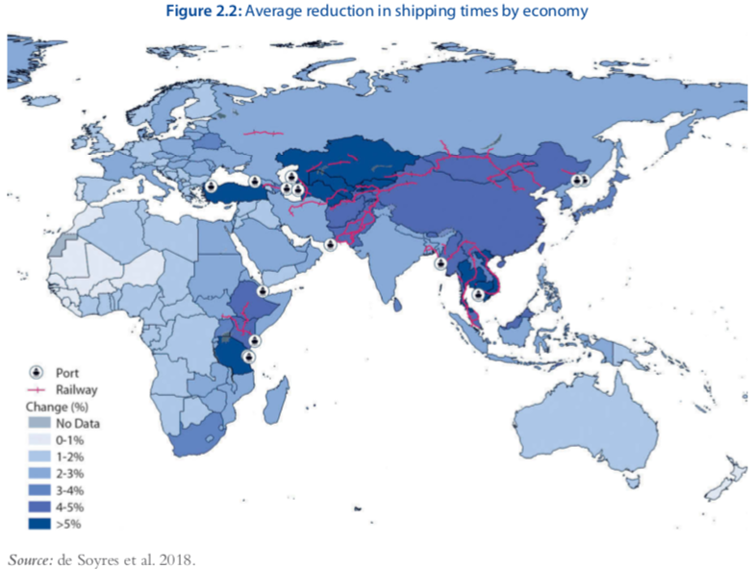
Shipping times will fall, some more than 5%
Source: World Bank, 2019, Belt and Road Economics: Opportunities and Risks of Transport Corridors
Notes:
World Bank 2019

Slide 51
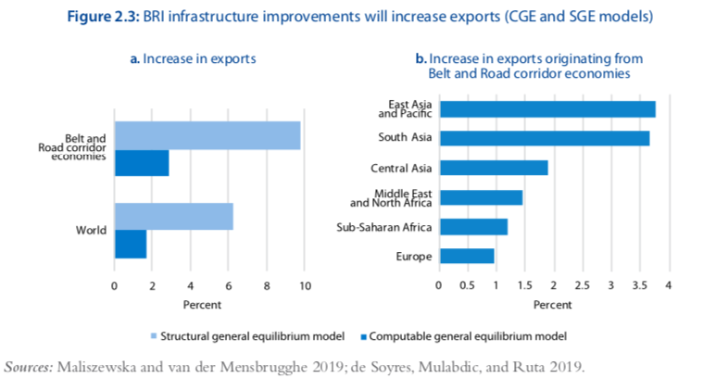
Exports will increase (amounts vary by place and model)
Source: World Bank, 2019, Belt and Road Economics: Opportunities and Risks of Transport Corridors
Notes:
World Bank 2019

Slide 52
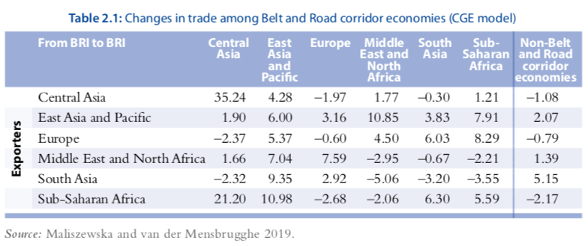
Most trade flows will rise, but some will fall
Source: World Bank, 2019, Belt and Road Economics: Opportunities and Risks of Transport Corridors
Notes:
World Bank 2019

Slide 53
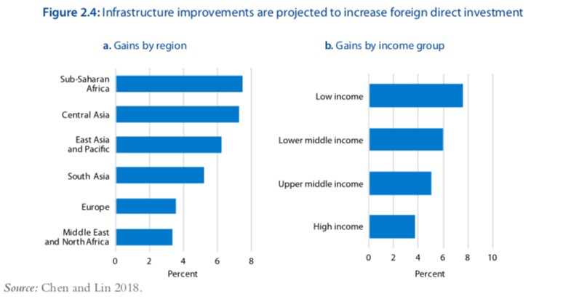
Countries will get more foreign investment
Source: World Bank, 2019, Belt and Road Economics: Opportunities and Risks of Transport Corridors
Notes:
World Bank 2019

Slide 54
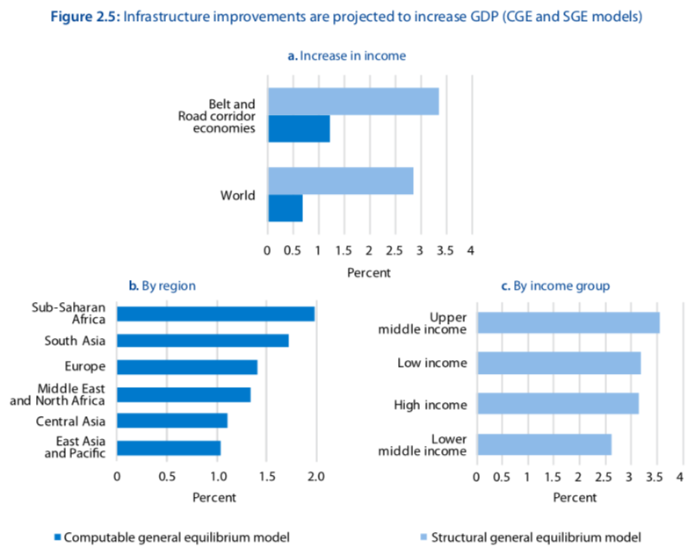
Countries’ GDP will rise (amounts vary by place and model)
Source: World Bank, 2019, Belt and Road Economics: Opportunities and Risks of Transport Corridors
Notes:
World Bank 2019

Slide 55
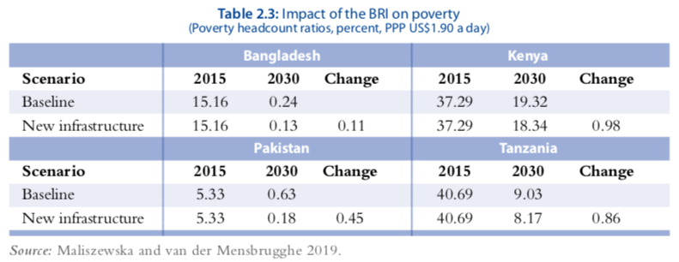
Poverty will fall faster than without BRI infrastructure
Source: World Bank, 2019, Belt and Road Economics: Opportunities and Risks of Transport Corridors
Notes:
World Bank 2019

Slide 56
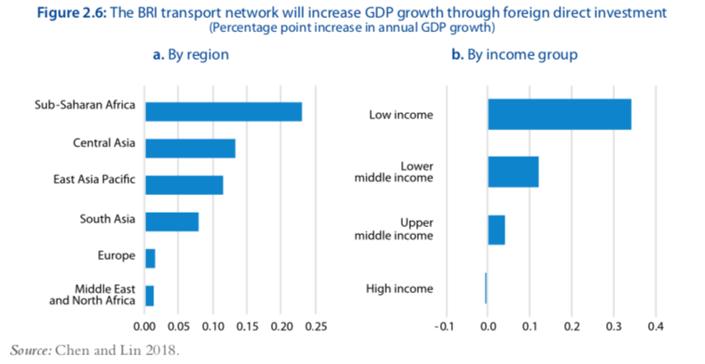
Growth rates will rise slightly
Source: World Bank, 2019, Belt and Road Economics: Opportunities and Risks of Transport Corridors
Notes:
World Bank 2019

Slide 57
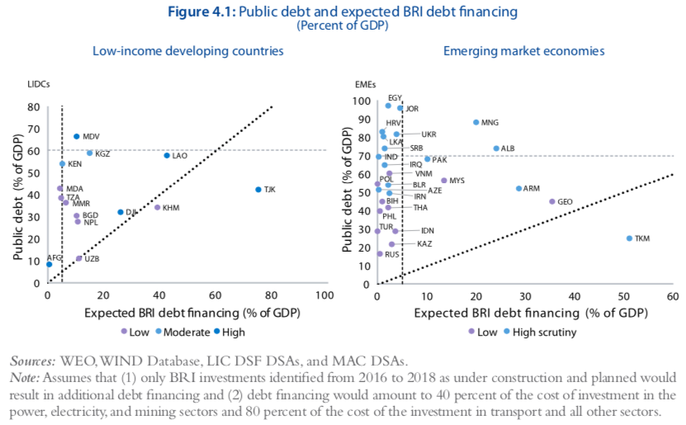
Public debt will increase, dangerously so in some countries
Source: World Bank, 2019, Belt and Road Economics: Opportunities and Risks of Transport Corridors
Notes:
World Bank 2019

Slide 58
Effects of BRI
Effects from Bird et al.
  Sample countries and their data
  Real income gains from BRI

Slide 59
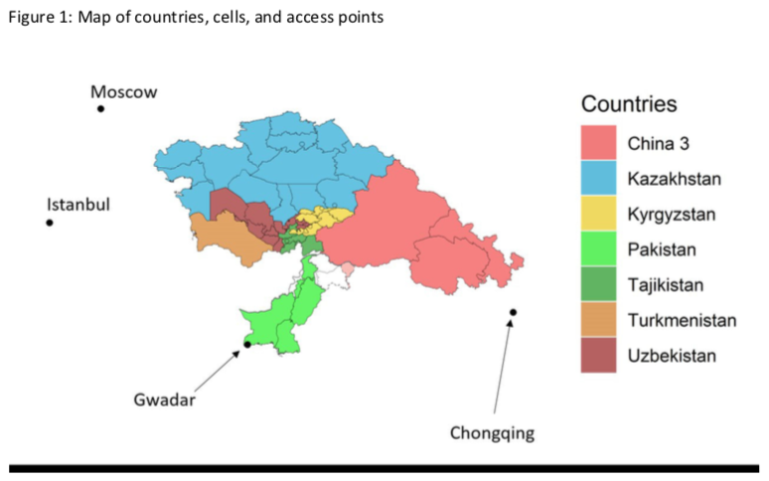
Source: Bird et al., 2019
Notes:
Bird, Julia, Mathilde Lebrand, and Anthony J. Venables, “The Belt and Road Initiative: Reshaping Economic Geography in Central Asia?” World Bank Group, Policy Research Working Paper, No. 8807, April 2019.

Slide 60
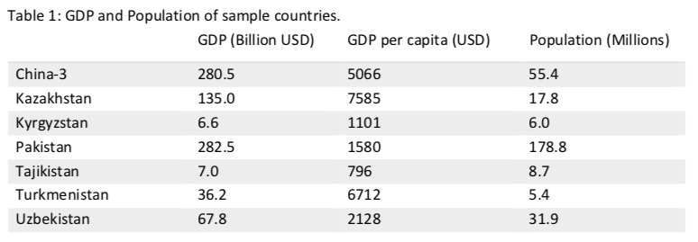
Sample countries differ
Source: Bird et al., 2019
Notes:
Bird, Julia, Mathilde Lebrand, and Anthony J. Venables, “The Belt and Road Initiative: Reshaping Economic Geography in Central Asia?” World Bank Group, Policy Research Working Paper, No. 8807, April 2019.

Slide 61
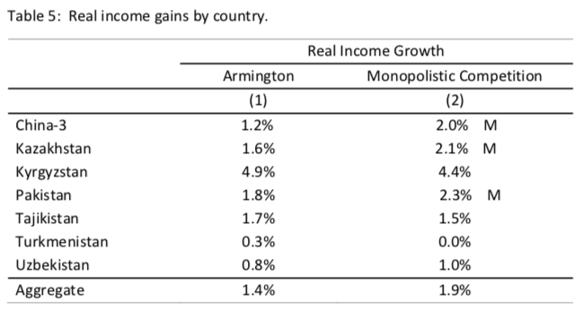
BRI will increase growth in real incomes
Source: Bird et al., 2019
Notes:
Bird, Julia, Mathilde Lebrand, and Anthony J. Venables, “The Belt and Road Initiative: Reshaping Economic Geography in Central Asia?” World Bank Group, Policy Research Working Paper, No. 8807, April 2019.

Slide 62
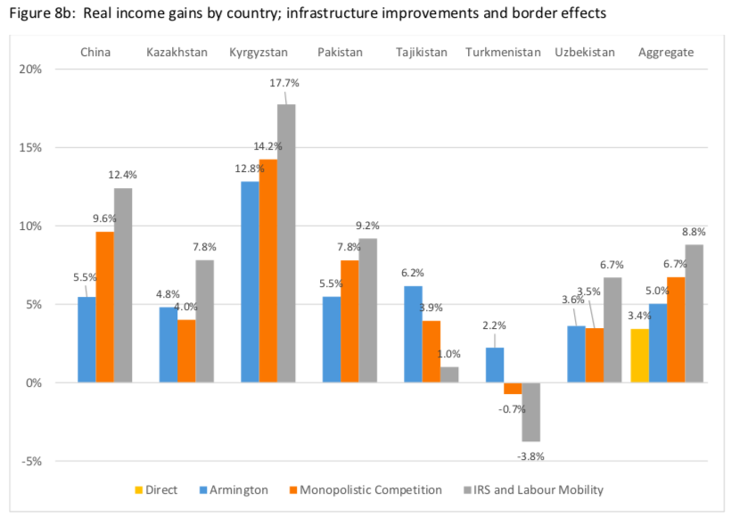
Gains vary by country and model
Source: Bird et al., 2019
Notes:
Bird, Julia, Mathilde Lebrand, and Anthony J. Venables, “The Belt and Road Initiative: Reshaping Economic Geography in Central Asia?” World Bank Group, Policy Research Working Paper, No. 8807, April 2019.

Slide 63
Effects of BRI
Effects from de Soyres et al., 2019
  GDP gains and changes in trade costs

Slide 64
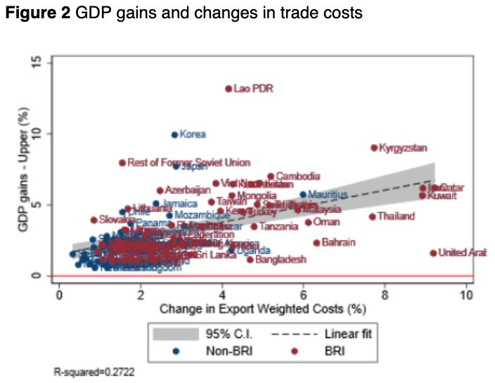
Countries differ greatly in their ability to take advantage of reduced trade costs
Source: de Soyres et al. 2019
Notes:
de Soyres, Francois, Alen Mulabdic, and Michele Ruta, “Common transport infrastructure: Welfare effects of the Belt and Road Initiative,” VOX CEPR Policy Portal, July 12, 2019.

Slide 65
Effects of BRI
Other Effects
  Debt
  Environment

Slide 66
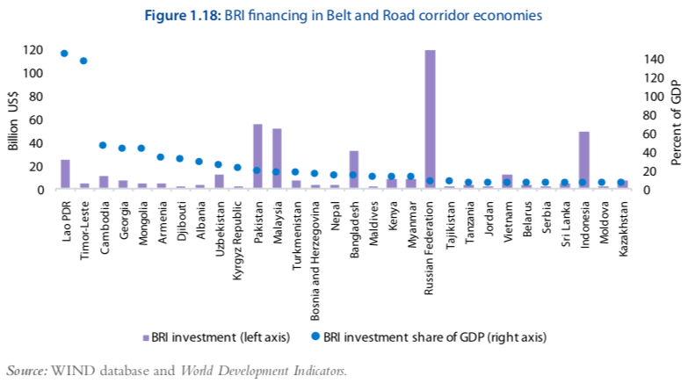
BRI debts, and debt burdens, vary greatly
Most $ to Russia, Pakistan, Malaysia, Bangladesh, & Indonesai
Most per GDP to Laos and Timor-Leste
Source: World Bank, 2019, Belt and Road Economics: Opportunities and Risks of Transport Corridors
Notes:
World Bank 2019

Slide 67
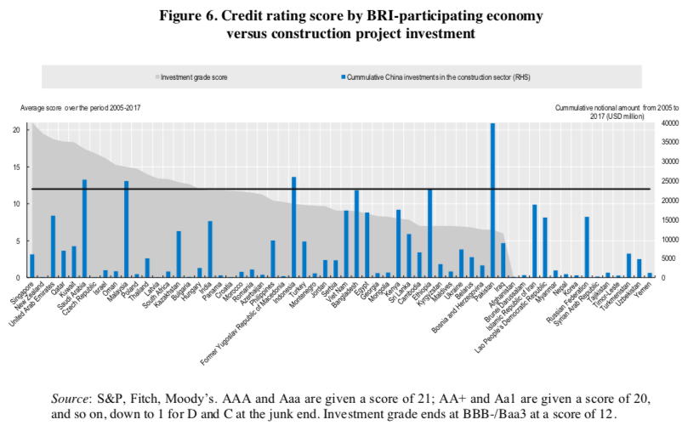
BRI investment is only loosely related to credit scores
Source: OECD 2018
Notes:
OECD, “China’s Belt and Road Initiative in the global trade, investment and finance landscape,” Chapter 2 of OECD Business and Economic Outlook, 2018.
https://www.google.com/url?sa=t&rct=j&q=&esrc=s&source=web&cd=17&ved=2ahUKEwiiqN62ipDlAhUMY6wKHUCrCzQQFjAQegQICRAC&url=https%3A%2F%2Fwww.oecd.org%2Ffinance%2FChinas-Belt-and-Road-Initiative-in-the-global-trade-investment-and-finance-landscape.pdf&usg=AOvVaw10mHVlaLTSNB4ukygVkxBy

Slide 68
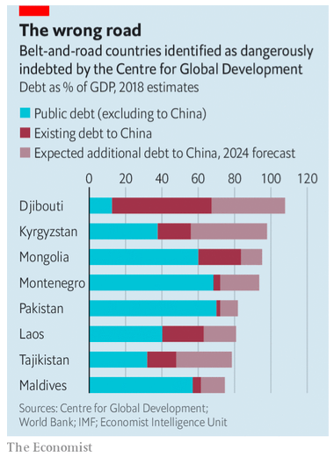
Some BRI countries are “dangerously indebted”
Notes:
Economist - China tries to calm jitters about the “Belt and Road” initiative - A trap of one’s own 2019

Slide 69
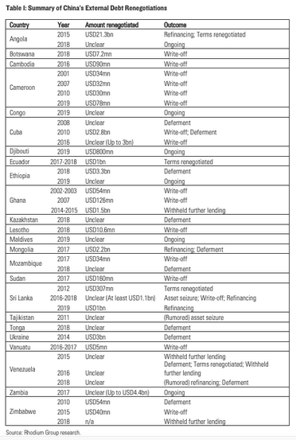
However, China is open to debt renegotiation. Many have had their debts
Written off
Deferred
Terms adjusted
Source: Kratz et al. 2019
Notes:
Kratz, Agatha, Allen Feng, and Logan Wright, “New Data on the “Debt Trap” Question,” Rhodium Group, April 29, 2019.
https://rhg.com/research/new-data-on-the-debt-trap-question/

Slide 70
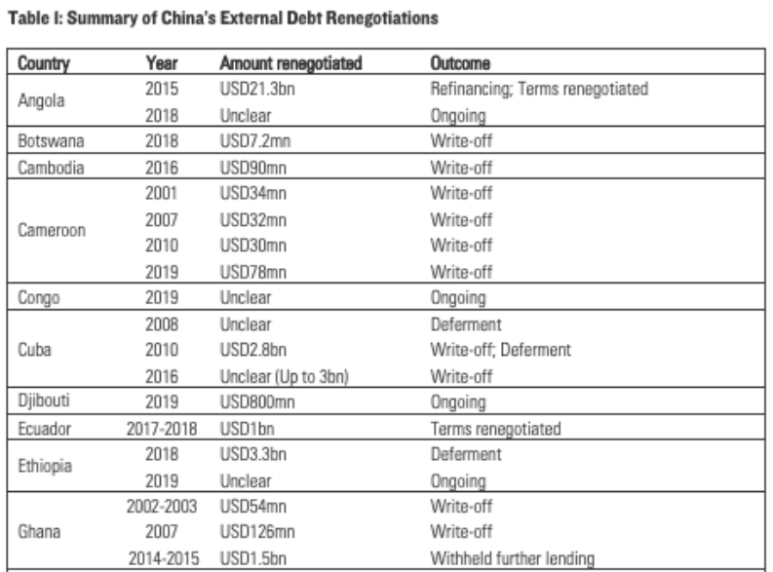
Source: Kratz et al. 2019
Notes:
Kratz, Agatha, Allen Feng, and Logan Wright, “New Data on the “Debt Trap” Question,” Rhodium Group, April 29, 2019.
https://rhg.com/research/new-data-on-the-debt-trap-question/

Slide 71
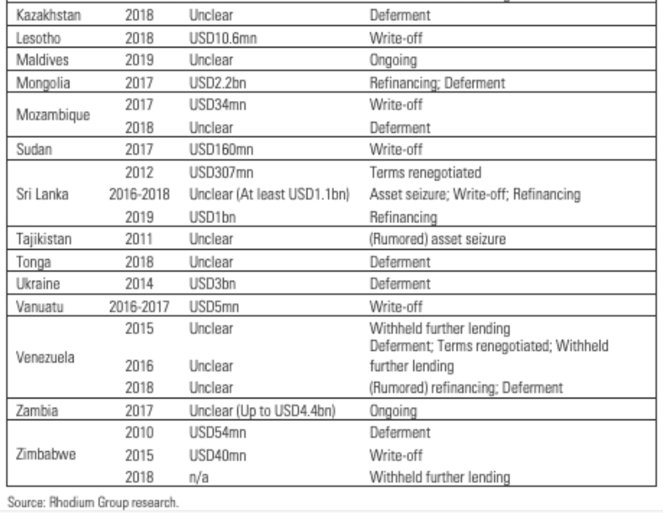
Source: Kratz et al. 2019
Notes:
Kratz, Agatha, Allen Feng, and Logan Wright, “New Data on the “Debt Trap” Question,” Rhodium Group, April 29, 2019.
https://rhg.com/research/new-data-on-the-debt-trap-question/

Slide 72
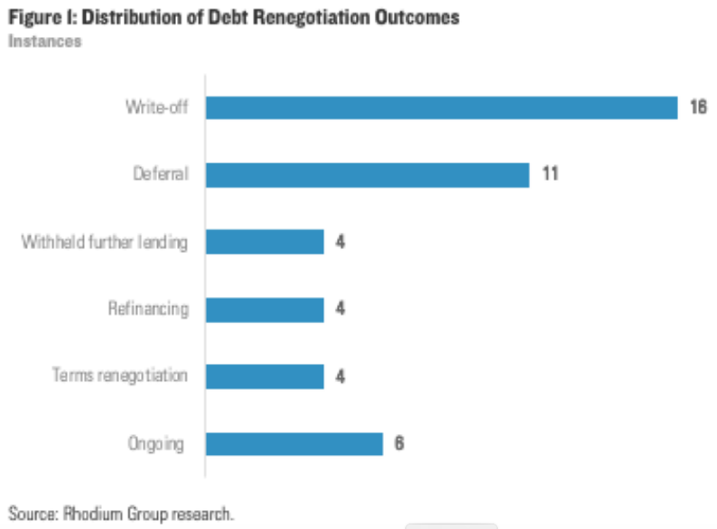
Source: Kratz et al. 2019
Notes:
Kratz, Agatha, Allen Feng, and Logan Wright, “New Data on the “Debt Trap” Question,” Rhodium Group, April 29, 2019.
https://rhg.com/research/new-data-on-the-debt-trap-question/

Slide 73
Environment effects
“Many of BRI’s major corridors are known to pass through ecologically sensitive areas.”
  Teese, Patrick, “Exploring the Environmental Repercussions of China’s Belt and Road Initiative,” EESI, October 30, 2018.
“Deforestation risks are especially high in Southeast Asia.”
  Losos, Elizabeth, Alexander Pfaff, and Lydia, “The Deforestation Risks of China’s Belt and Road Initiative,” Brookings, January 28, 2019.
“In 2018, over 40 percent of the BRI lending for the power sector was still in coal projects.”
  Nakano, Jane, “Greening or Greenwashing the Belt and Road Initiative?” Center for Strategic and International Studies, May 1, 2019.
“Much of the infrastructure China is planning and building through the BRI has cascading risk potential [for the environment].”
  Ewing,, Jackson, “Making the Belt and Road Environmentally Sustainable: ‘Greening’ the BRI is a two-way street that starts in Beijing,” The Diplomat, May 3, 2019.
Notes:
https://www.eesi.org/articles/view/exploring-the-environmental-repercussions-of-chinas-belt-and-road-initiative
https://www.brookings.edu/blog/future-development/2019/01/28/the-deforestation-risks-of-chinas-belt-and-road-initiative/
https://www.csis.org/analysis/greening-or-greenwashing-belt-and-road-initiative
https://thediplomat.com/2019/05/making-the-belt-and-road-environmentally-sustainable/

Slide 74
BRI
Pros and Cons

Slide 75
Pros and Cons of BRI
Pros
  These countries are poor and need infrastructure to develop
  Assistance from rich countries and World Bank comes with strings
  Gives China an outlet for its excess production
Cons
  Debt to China may be hard to manage
  If countries default, China may take ownership
  China uses mostly its own firms and workers to build
Notes:
Ibold, Sebastian, “Cooperation agreements and MoUs under the Belt and Road Initiative,” Belt and Road Initiative.
https://www.beltroad-initiative.com/memorundum-of-understanding-belt-and-road-initiative/#more-1881

Slide 76
BRI
Implications for US

Slide 77
Implications of BRI for US
Implications for US
  Direct effects: few
  US benefits from infrastructure built by China
But…
  Chinese-built infrastructure may give China access and control
  China expands its sphere of influence
  China will “make the rules” of the future world economy
  It marginalizes the US geostrategic influence in Asia, Africa, and perhaps Europe
Notes:
Cavanna, Thomas P., “What Does China’s Belt and Road Initiative Mean for US Grand Strategy?” The Diplomat, June 5, 2018.
https://thediplomat.com/2018/06/what-does-chinas-belt-and-road-initiative-mean-for-us-grand-strategy/

Slide 78
Thank you!
Thank you!
Any Questions?
Alan V. Deardorff
Ford School of Public Policy
University of Michigan
www.NEEDelegation.org

